Slide 1
CSE 12 – Basic Data Structures and Object-Oriented Design Lecture 16
Greg Miranda & Paul Cao, Winter 2021
This lecture is being recorded

Slide 2
Announcements
Quiz 16 due Wednesday @ 8am
Survey 6 due tonight @ 11:59pm
PA6 due Wednesday @ 11:59pm
Practice Map Problems – see schedule

Slide 3
Topics
Map and HashTable
Questions on Lecture 16?

Slide 4
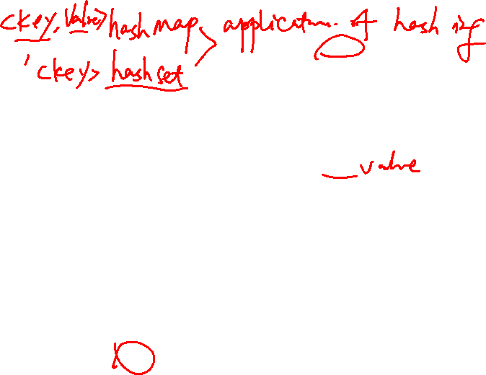
Hashing
Hash table (array)
index
data
Let’s modify our array-based look up table
Need a hash-function h(x): takes in a key, returns an index in the array
gold standard: random hash function
In general, no null value is allowed in table
Table size is fixed and in general large
(might be collisions)
HC
Key
Hash Code (HC)
Size is proportional to # of keys (not value of keys)
Hash function
(must be fast)
Key

Slide 5
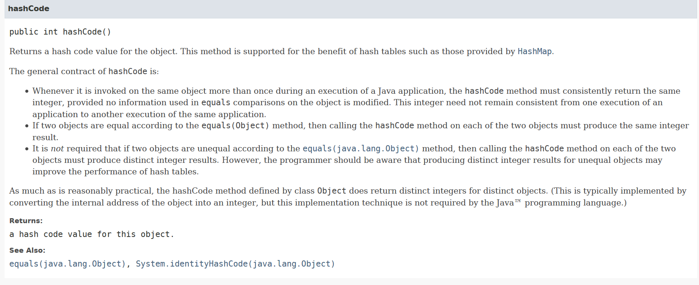
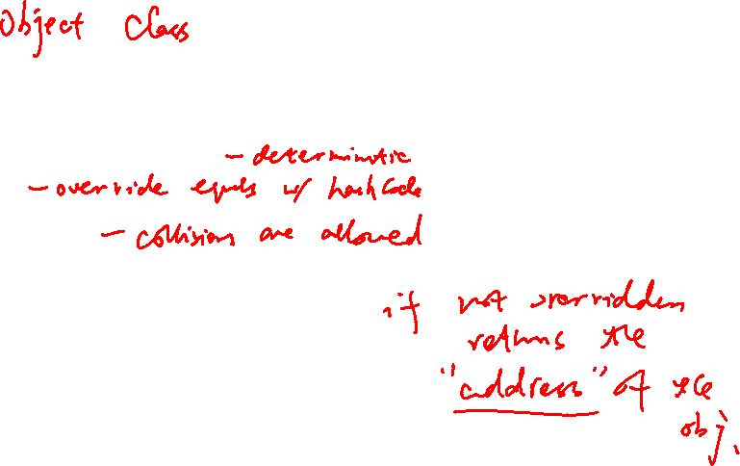
What if every element of type E defined a method called "getLocationInArray()" that was guaranteed to return a unique int value between 0 and 999.
Generates a number that can be used by a hash function (or simply as the hash value itself)

Slide 6

In general, what is the difference between the value returned by hashCode() and the index location where the item ends up in a particular hash table?
Nothing. The value returned by hashCode can be used directly as the index for the item in any hash table
The value returned by hashCode might be larger than the size of the hash table
The hashCode function might return the same value for two different objects, and indexes in hash tables must always be unique for different objects
The hashCode function might return different values for two objects that are considered equal (and for hash tables, two values that are considered equal must have the same hashcode/index value)
But Java (almost) has this method!

Slide 7
Hash functions
A hash function maps an object or key to a position in an array (the hash table). What properties are required and/or desired from a good hash function?

Slide 8
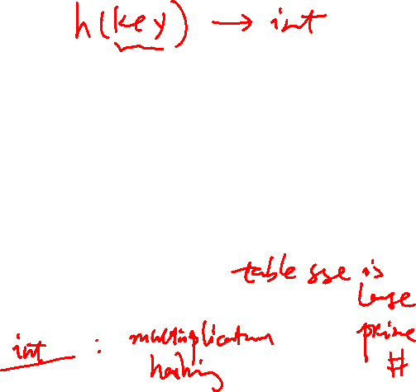
Hash function
To be useful, a hash function must be fast
Its performance should not depend on the particular key.
Runs in "constant time" (more on this later…)
A hash function must also be deterministic:
Given the same value, it must always return the same array index. (Otherwise, how would we find something we stored earlier?)
A “good” hash function should also be uniform:
Each “slot” i in the array should be equally likely to be chosen as any other slot j.

Slide 9

Hashing Is Cool
Probably most used and important data structure in CSE
Probably in every system you’ve ever used
Part of every modern programming language
Remember it’s derived from Dictionary ADT
Key, value pair (insert, delete, and search)
Does the key exist, if so, give me the item associated with that key
Assuming no two items have the same key

Slide 10
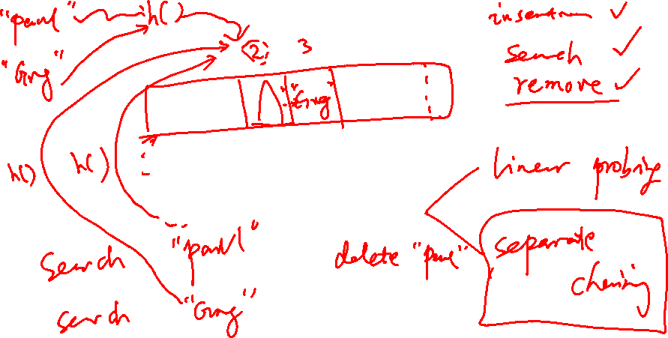
Collision Resolution Strategies

Slide 11
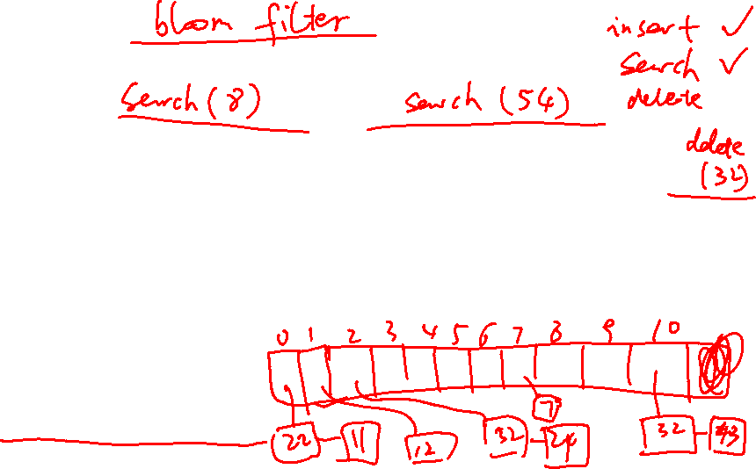
Collision resolution: Separate Chaining
Insert the numbers below into a hash table of size M=11 using the hash function H(k)=k % M. Perform each of the following:
Separate chaining collision resolution without resizing What is the load factor?
Separate chaining collision resolution WITH resizing with the 8th element is inserted (double M to 22). What is the final load factor?
{22, 32, 43, 11, 12, 35, 24, 7}

Slide 12
{22, 32, 43, 11, 12, 35, 24, 7}

Slide 13
Collision resolution: Separate Chaining
The idea is to keep a list of all elements that hash to the same value.
The array elements are pointers to the first nodes of the lists.
A new item is inserted to the front of the list.
Why the front? O(1) insertion
Advantages
Better space utilization for large items.
Simple collision handling: searching linked list.
Overflow: we can store more items than the hash table size.
Deletion is quick and easy: deletion from the linked list.
Disadvantage
Complicated data structure. Array of link list.

Slide 14
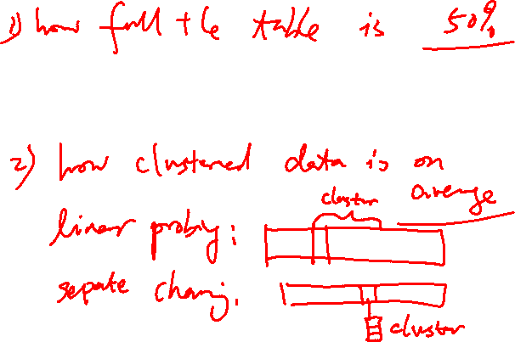
Analysis of Separate Chaining
Load factor definition
Ratio of number of elements (M) in a hash table to the hash TableSize.
Load factor = M/TableSize.
The average length of a list is also a load factor.

Slide 15
Table size as prime number
Table size as a prime number helps minimize clustering
Doubling the table size using prime numbers.
https://www.planetmath.org/goodhashtableprimes

Slide 16
Strings as keys
Keys are not always integers.
The classic example is a dictionary. If you want to put every word of an English-language dictionary, from a to zyzzyva
(who knows what it is and how to pronounce it?)
into your computer’s memory so they can be accessed quickly, a hash table is a good choice.
A similar widely used application for hash tables is in computer-language compilers, which maintain a symbol table in a hash table.
The symbol table holds all the variable and function names made up by the programmer, along with the address where they can be found in memory.
https://en.wikipedia.org/wiki/Symbol_table

Slide 17

Converting words to numbers
Let’s say we want to store a 50,000-word English-language dictionary in main memory
Question: Use the length of a word as a hash function:
A: It is a good choice
B: It is not uniform
C: It is not fast
D: It is not deterministic
Notes:
B

Slide 18
Converting words to numbers (50,000-words)
Another idea: Use ASCII code, in which a is 97, b is 98, and so on, up to 122 for z. Then add the numbers.
Let’s say a is 1, b is 2, c is 3, and so on up to 26 for z. We’ll also say a blank is 0, so we have 27 characters. (assume no capitals).
I subtracted 96 to make the math easier.
“cat”= 3 + 1 + 20 = 24.
A: It is a good choice
B: It is not uniform
C: It is not fast
D: It is not deterministic
Notes:
B

Slide 19
Converting words to numbers (multiplying powers)
Idea: Hash each word into a unique location.
How? Number analogy:
7,546 = 7*1000 + 5*100 + 4*10 + 6*1
(or using powers of 10):
7,546 = 7*10³ + 5*10² + 4*10¹ + 6*10⁰
Why base 10? Because there are 10 possible digits.

Slide 20
Converting words to numbers (multiplying powers)
Why base 10? Because there are 10 possible digits.
If we are apply the same idea to strings, what is our base?
A: 10
B: 27 (26 letters and the space)
C: Can’t apply the method
Notes:
B

Slide 21
Converting words to numbers (multiplying powers)
We will use base 27 because we have 26 letters and 1 space.
“cat”: c = 3, a = 1, t = 20.
What is the corresponding conversion?
H(cat) = 3*27² + 1*27¹ + 20*27⁰

Slide 22
Converting words to numbers (multiplying powers)
The largest 10-letter word (let’s assume 10 is the max length of the word), zzzzzzzzzz, translates into …
?

Slide 23
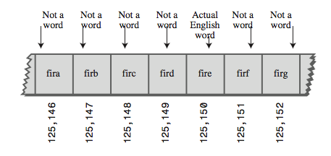
Converting words to numbers (multiplying powers)
The largest 10-letter word (let’s assume 10 is the max length of the word), zzzzzzzzzz, translates into …
26*27⁹ + 26*27⁸ + 26*27⁷ + 26*27⁶ + 26*27⁵ + 26*27⁴ + 26*27³ + 26*27² + 26*27¹ + 26*27⁰ ←HUGE NUMBER.
Another problem:

Slide 24
Conclusion
Our first scheme—adding the numbers—generated too few indices.
This latest scheme—adding the numbers times powers of 27—generates too many.
Hash Tables have large but reasonable size. We will use the second approach with some changes.
key = 3*27² + 1*27¹ + 20*27⁰
index = (key) % tableSize;

Slide 25
Hash Strings: “cat” hashVal= 3*27² + 1*27¹ + 20*27⁰
public static int hashFunc1(String key) {
int hashVal = 0;
int pow27 = 1; // 1, 27, 27*27, etc
for (int j=key.length()-1; j>=0; j--) { // right to left
int letter = key.charAt(j) - 96; // char code
hashVal += pow27*letter; // times the power of 27
pow27 *= 27; // Increase the power
}
return hashVal % tableSize; // mod by table size
}

Slide 26
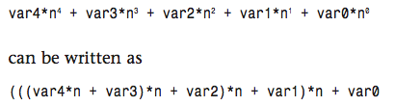
Not efficient yet
Aside from the character conversion, there are two multiplications and an addition inside the loop
Horner’s Method.

Slide 27
Another version (Horner's method)
public static int hashFunc2(String key) {
int hashVal = key.charAt(0);
int pow27 = 1; // 1, 27, 27*27, etc
for (int j=1; j<key.length(); j++) { // left to right
int letter = key.charAt(j) - 96; // char code
hashVal = hashVal*27 + letter; // multiply and add
}
return hashVal % tableSize; // mod by table size
}
There's still at least one problem for long strings…

Slide 28
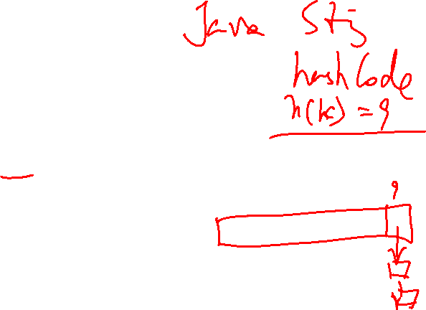
Final improvement
public static int hashFunc_final(String key) {
int hashVal = key.charAt(0);
int pow27 = 1; // 1, 27, 27*27, etc
for (int j=1; j<key.length(); j++) { // left to right
int letter = key.charAt(j) - 96; // char code
hashVal = (hashVal*27 + letter) % tableSize; // multiply and add
}
return hashVal;
}

Slide 29
Even faster
Various bit- manipulation tricks can be played as well, such as
using a base of 32 (or a larger power of 2) instead of 27, so that multiplication can be effected using the shift operator (>>),

Slide 30
Folding: another idea
For larger strings: (length over 7)
Group more than one digit. (2, 3, 4).
Add them.
% tableSize.

Slide 31
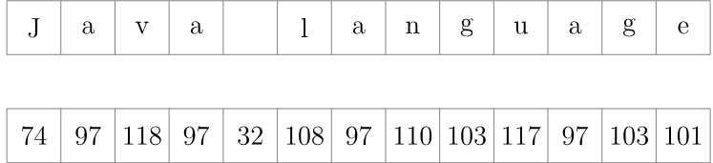
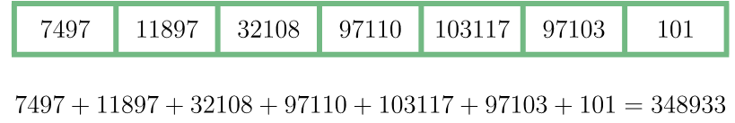
Folding Example
Let's start by converting the string's characters into numbers. ASCII is a good candidate for this operation:
Now, we arrange the numbers we just obtained into groups of some size. Generally, we choose the group size value based on the size of our array which is 10⁵. Since the numbers, in which we transformed the characters into, contain from two to three digits, without loss of generality, we may set the group size to two:
The next step is to concatenate the numbers in each group as if they were strings and find their sum:
Now we must make the final step. Let's check whether the number 348933 may serve as an index of our array of size 10⁵. Naturally, it exceeds the maximum allowed value 99999. We may easily overcome this problem by applying the modulo operator in order to find the final result:
348933 % 10000 = 48933

Slide 32
More ideas
A few word documents with different hash function ideas. There are a few implementations in C++ so you can convert to Java. (credit goes to Geoff Kuenning)
Statistics:
http://programmers.stackexchange.com/questions/49550/which-hashing-algorithm-is-best-for-uniqueness-and-speed

Slide 33
Hash Table – draw the picture (Separate Chaining)
int getIndex(String k) {
return k.length;
}
# of buckets – 6
(i.e. the size of the array)
set(“Smith”, 1);
set(“Maria”, 2);
set(“Christine”, 3);
set(“Brown”, 4);
set(“Julia”, 5);
set(“Garcia”, 6);
set(“Miller”, 7);
set(“Davis”, 8);
set(“Wesley”, 9);
set(“Martinez”, 10);

Slide 34
Hash Table – draw the picture (Separate Chaining)
int getIndex(String k) {
return k.length;
}
set(“Smith”, 1);
set(“Maria”, 2);
set(“Christine”, 3);
set(“Brown”, 4);
set(“Julia”, 5);
set(“Garcia”, 6);
set(“Miller”, 7);
set(“Davis”, 8);
set(“Wesley”, 9);
set(“Martinez”, 10);
# of buckets – 4
(i.e. the size of the array)
expandCapacity() called in set()
LoadFactor – 0.75

